Slide 1
Design of protein-binding proteins from the target structure alone 2022 (Longxing Cao, Brian Coventry)

Slide 2
Basic Idea:
Antibodies bind to RBD to neutralize the SARS COV-2 effect.
We need to make binders for neutralization and blocks the ACE2 binding.
Binders are smaller than 65 amino acids and are hyperstable.
Previous approaches:
They used conserved binding loops/hotspot residues to study native interfaces; like by seeing the shape complementarity and SASA.

Slide 3
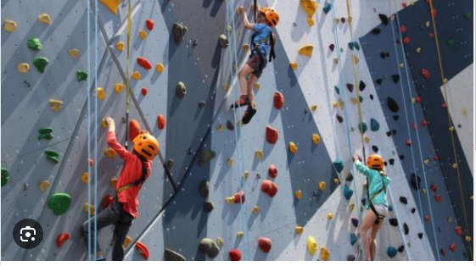
Simple analogy:
Consider the simple analogy of a difficult climbing wall with only a few suitable footholds or handholds distant from each other.
identify all the possible handholds and footholds, no matter how poor or good they are.
have thousands of climbers and try to climb the wall
identify those routes that showed the most promise
And at last, have a second group of climbers explore them in detail.

Slide 4
The de novo approach:
identify all the possible handholds and footholds, no matter how poor
have thousands of climbers select subsets of these and try to climb the wall
identify those routes that showed the most promise
And at last, have a second group of climbers explore them in detail.
enumerate a large and comprehensive set of disembodied side-chain interactions with the target surface
identify from large in silico libraries of protein backbones those that can host many of these side chains without clashing with the target
identify recurrent backbone motifs in these structures
generate and place against the target a second round of scaffolds that contain these interacting motifs

Slide 5
RifDock, is an approach developed by the Baker lab for docking proteins to a ligand or another protein while simultaneously making mutations. This technique is particularly significant because it allows for the docking of proteins in a manner that includes the formation of strong interactions, such as hydrogen bonds and hydrophobic interactions, which are abundant in protein-protein binding interfaces.
RifGen is a component of the RifDock suite, which is utilized for protein-ligand docking. It generates various amino acid rotamers (referred to as RIFs. Using RifGen, a vast number of individual amino acids are tested against a target protein surface to find favorable interactions.

Slide 6
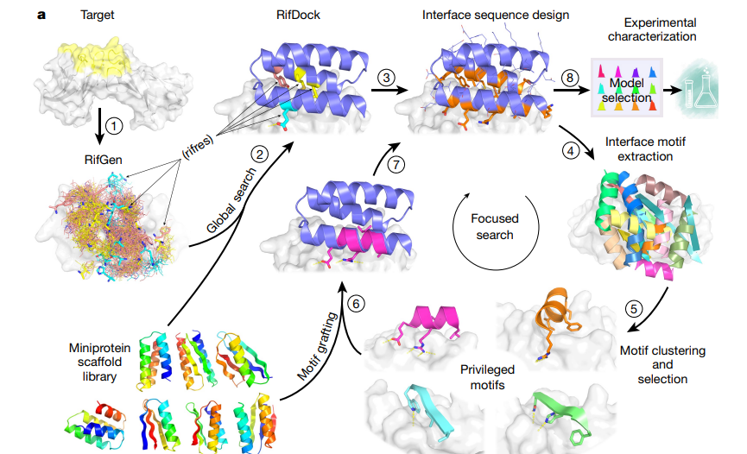

Slide 7
A total of 84,690 scaffolds spanning 5 different topologies, predictive of folding were encoded, and 34,507 of these were found to be stable using a high-throughput proteolysis-based protein stability assay.
The success in designing nanomolar affinity binders for 14 target sites demonstrates that binding proteins can be designed de novo using only information on the structure of the target protein, without the need for prior information.
The sites targeted here all contain at least four hydrophobic residues, the design of binders to highly polar target sites remains a considerable challenge.

